Slide 1
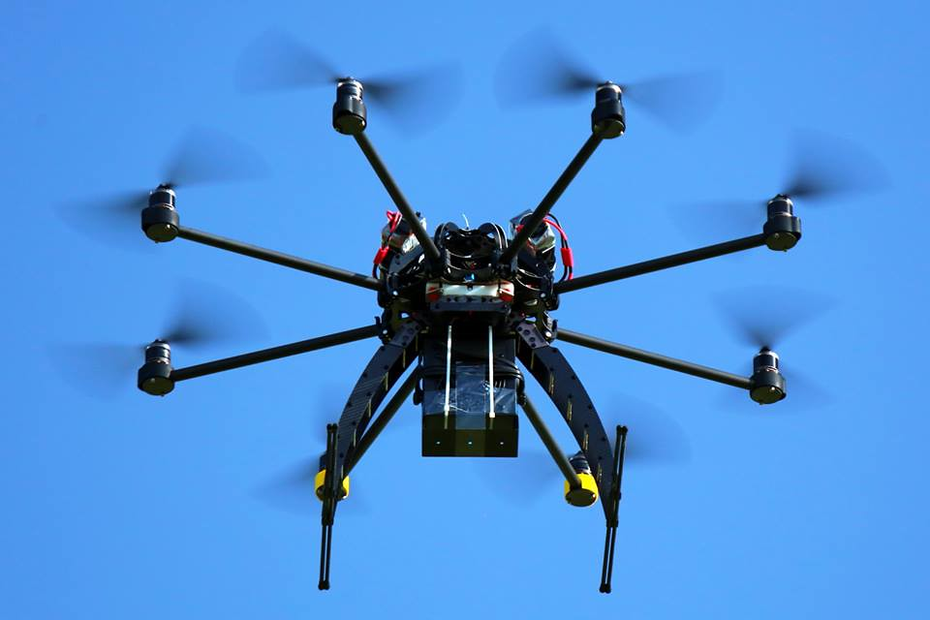
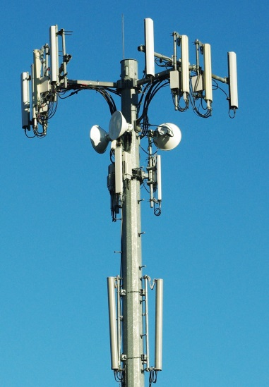
IETF 105 HotRFC: Trustworthy Multipurpose Remote ID
Bob Moskowitz, Stu Card, Adam Wiethuechter
Extending Locator/Identifier split & strong authentication techniques to identify physically nearby objects

Slide 2
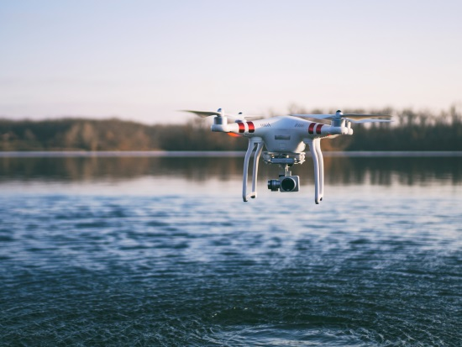
Unmanned Aircraft System (UAS) Remote ID
Need means to identify nearby observed Unmanned Aircraft (UA)
Complicated by small size, hi speed, remote operation, autonomy…
Urgent: US FAA Notice of Proposed Rule Making this September
Competing approaches from PHY on up, none entirely satisfactory
ASTM WK65041 draft: Open Drone ID messages / multi transports
Broadcast: Bluetooth 4 / 5 & WiFi beacons direct to local observer phone
Network: from UAS (e.g. via LTE) or proxy (e.g. operator phone) to Internet
Aviators familiar w/radio comms, not networking; IETF could help
strengthen authentication, balance operator privacy w/genuine Need To Know
generalize to support V2X, self-separation, collision avoidance…
what else?
UA physical location -> UA ID ~ host logical location (IP) -> host ID

Slide 3
Value of HITs as UA Remote ID
Provides Trustworthy Identity to pair with physical and logical location data
HITs are valid IPv6 addresses and can be used directly over broadcast media (e.g. BT)
With provable ownership (use HI for sig)
Full mobility and multihome support
Secure registration protocol for Identity bootstrap
First-come, first-own for ID

Slide 4
IETF work needed
Hierarchical HITs
Expanded registration process
Federated Registration Authorities
HIT meta-data update/retrieval based on authorization
New crypto support
e.g. EDDSA, KMAC, cSHAKE
HIs in CBOR Concise Identities
HIP as an OAUTH method
More TBD

Slide 5
IETF 105 side meeting: Trustworthy Multipurpose Remote ID
Monday 18:00 – 19:00 room C2
Stuart Card, Robert Moskowitz, Adam Wiethuechter
tm-rid@ietf.org

